Slide 1
Opening Slide Here
Optional secondary text goes here.

Slide 2
This is a bulleted text slide
Bullet number one
  And bullet number two
  Another bullet
    Why not a third level?
    This arrow is cute
      Level number four
        And level number five

Slide 3

This is an example of a caption
To use this slide with the white border flush against the image, right click to Format Picture and change all crop settings to ‘0’.

Slide 4
Opening slide or Chapter Marker
Optional subtitle text here

Slide 5
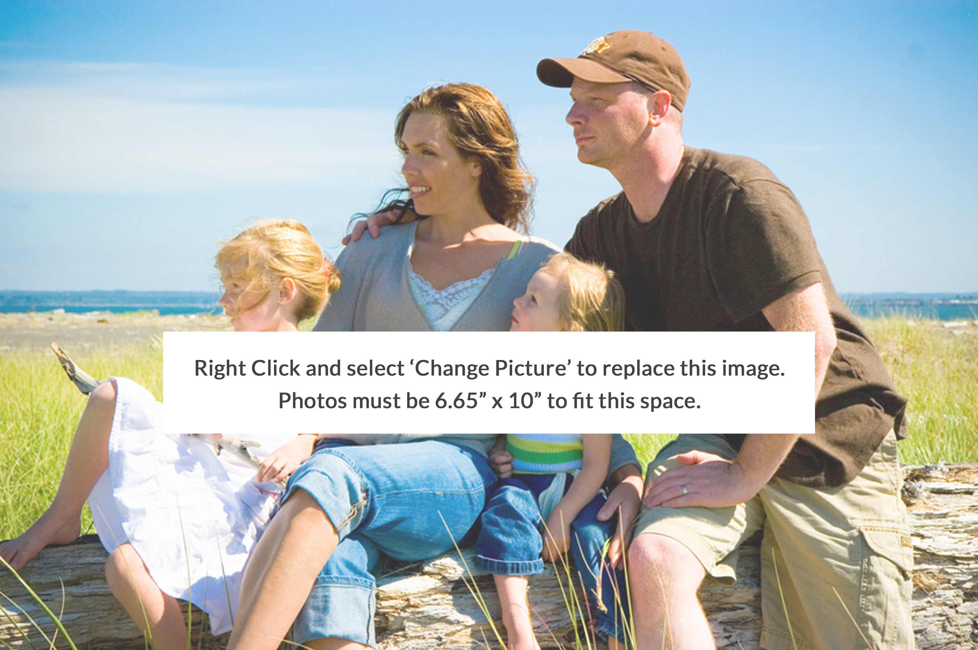


Slide 6
Sample Title Text Here
Here is a bit more text, a side note, if you will.
Here is a main bullet
And another one
One more
  And a secondary bullet

Slide 7

This is another sample image treatment… there are three.

